Slide 1

UNIVERSITY OF SCIENCE AND TECHNOLOGY MEGHALAYA
DEPARTMENT OF COMPUTER SCIENCE AND ELECTRONICS
A Minor Project on
“ADMISSION MANAGEMENT SYSTEM
Submitted by, Guided By:
Maitree Hazarika Mr. Rashidduzzaman Prodhani
17/BCA/27
Pollabi Talukdar
17/BCA/47

Slide 2
CONTENT
Objectives
Introduction
Requirement Analysis
DFD(Data Flow Diagram)
ER- Diagram
Table Structure
Data Dictionary
Conclusion

Slide 3
INTRODUCTION
It is a web based database software applications.
It is widely used in organization to maintain student details, admission details etc.
This system will help to make the admission process much easier.
It aimed to make easier and more convinient way for the admission process in educational institutes.
This project will make the process of admission management faster, more reliable and more accurate than performing this task manually.

Slide 4
Objectives
Admin can perform master entity for course detail.
Students can submit their forms and the form details are stored for further use.
To mange the admission process with less human efforts.
To reduce the workload of official staff involved in admission process.
To maintain integrity and consistency of data.

Slide 5
REQUIREMENT ANALYSIS
Hardware Specifications:
Processor: Intel®Core™i3
HardDisk: 1TB
RAM:4GB
RAM Type: DDR4
Processor Variant 6100U
Operating System: Microsoft Windows 10
Software Specifications:
Operating System: Microsoft Windows 10
Font End: Microsoft Visual Studio 2008
Back End: MySQL Server 2005

Slide 6
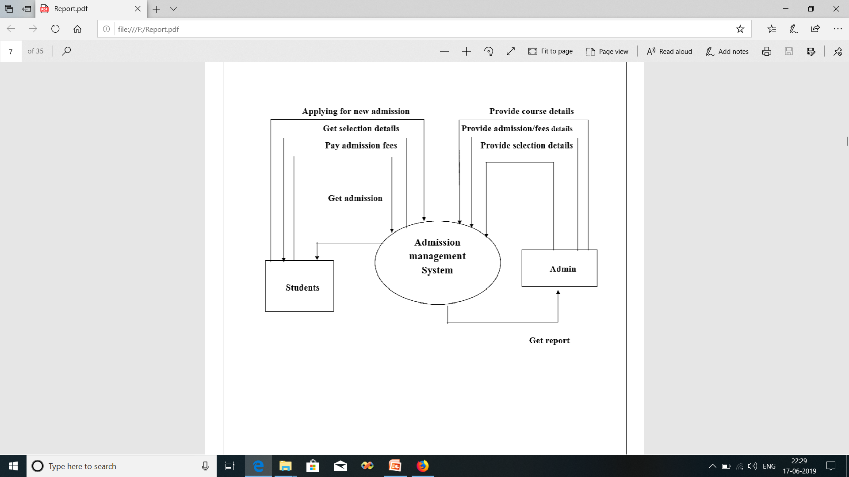
O level DFD( DATA FLOW DIAGRAM)

Slide 7
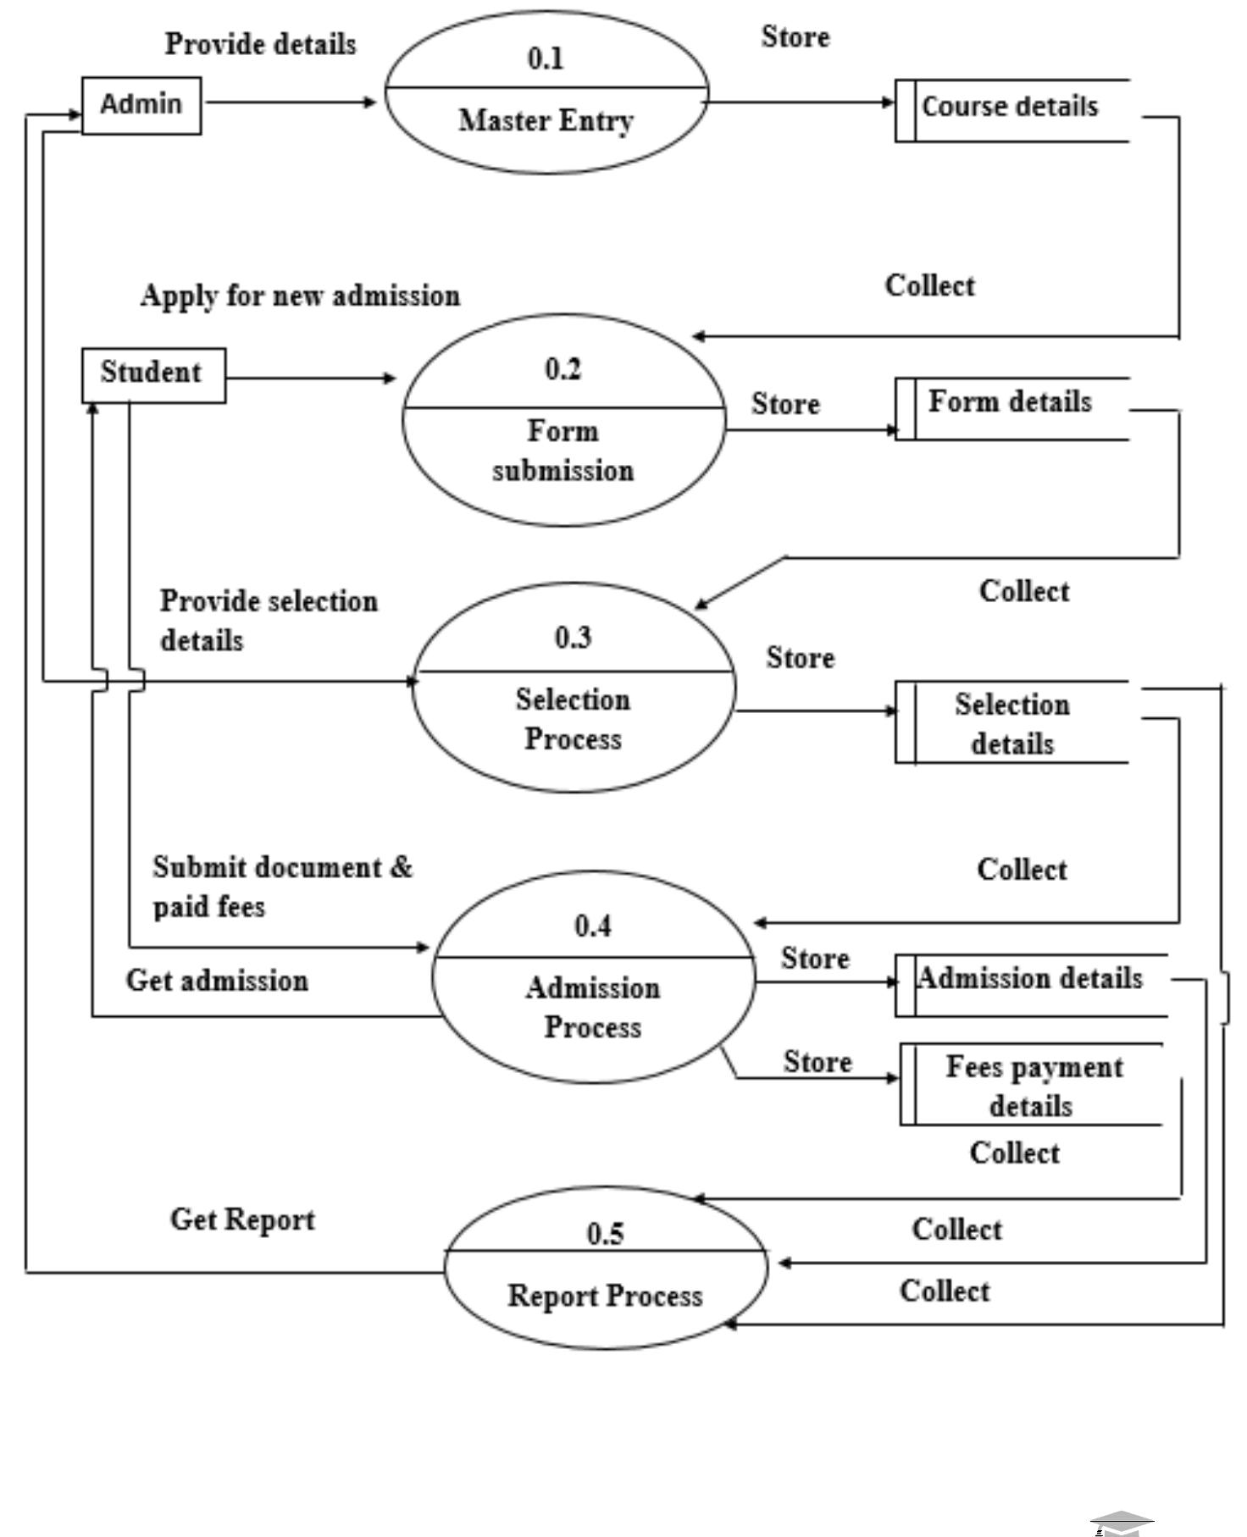
1st LEVEL DFD(DATA FLOW DIAGRAM)

Slide 8
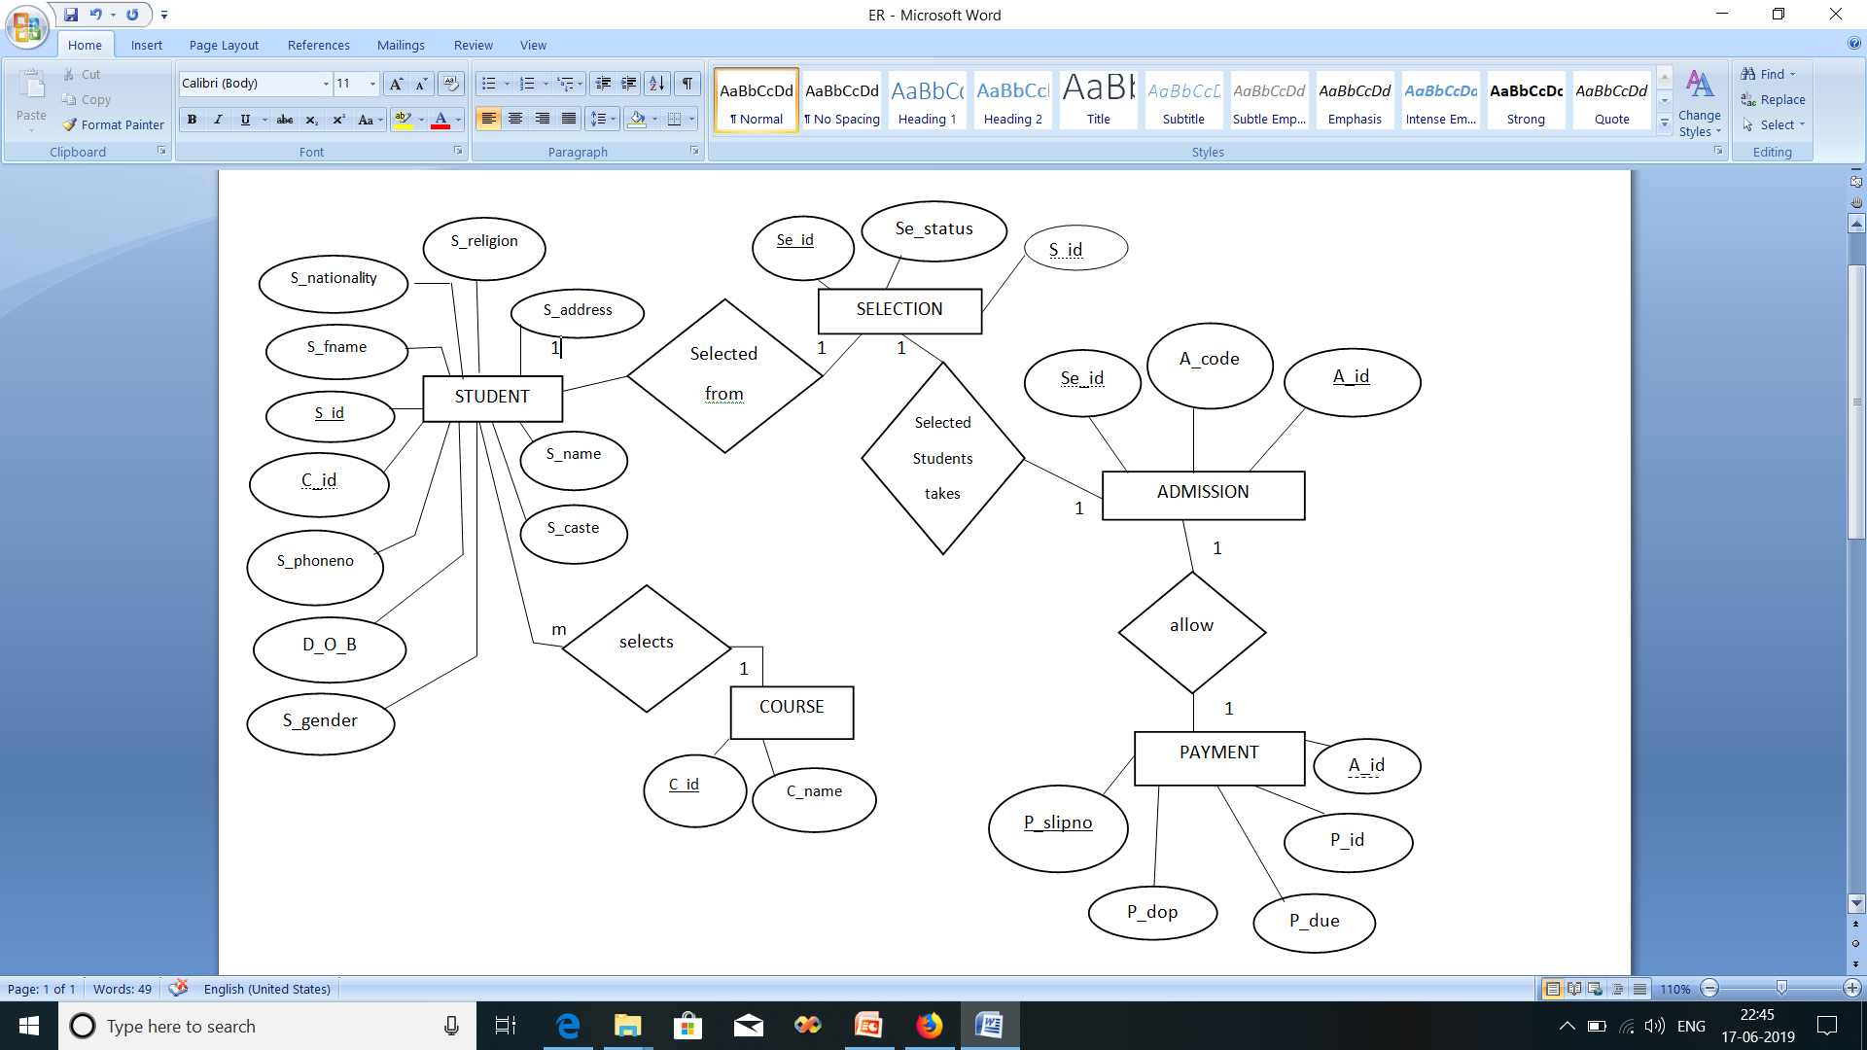
ER- DIAGRAM

Slide 9
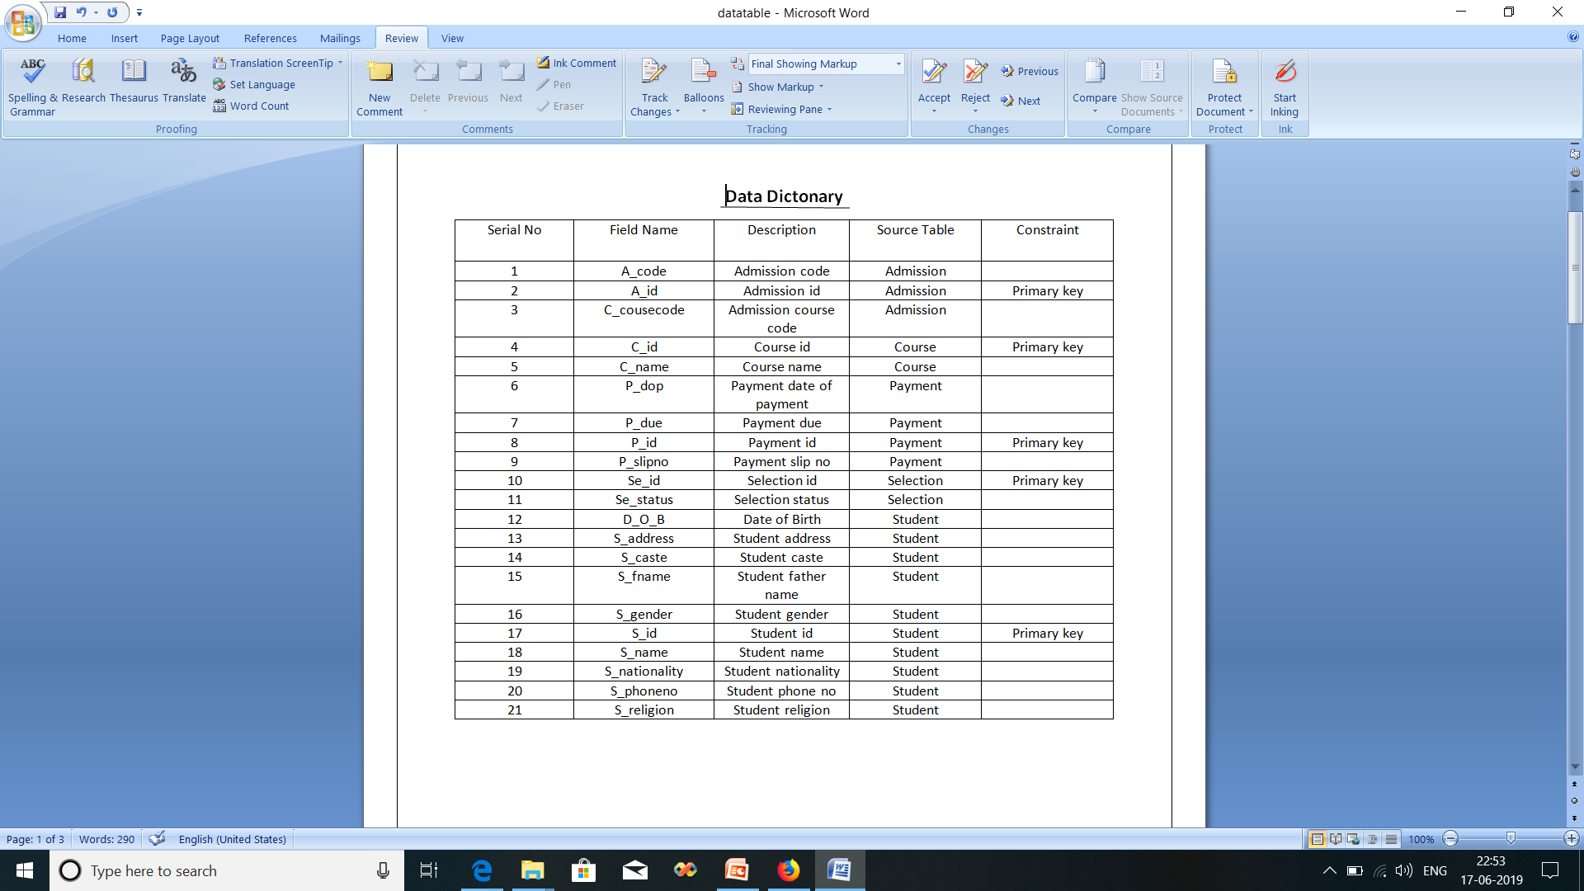
DATA DICTIONARY

Slide 10
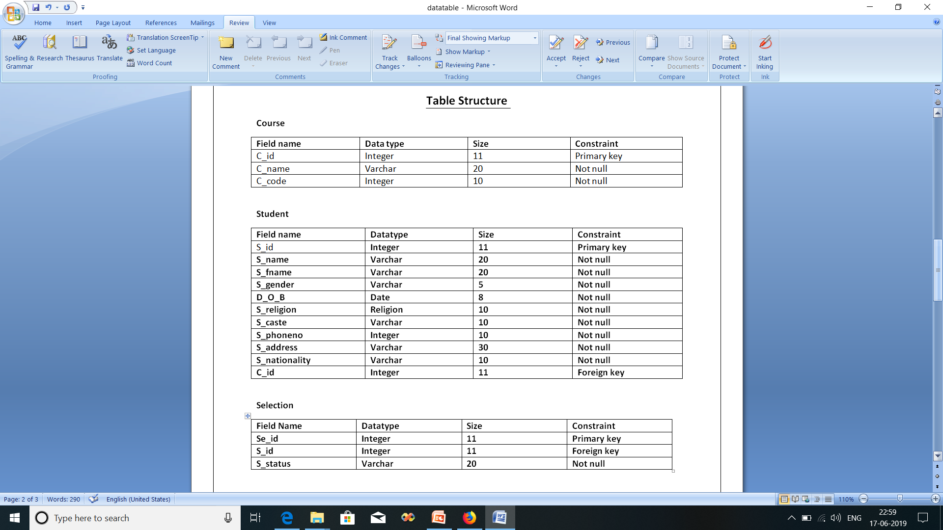
TABLE STRUCTURE

Slide 11
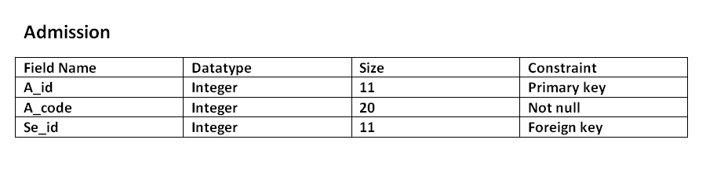
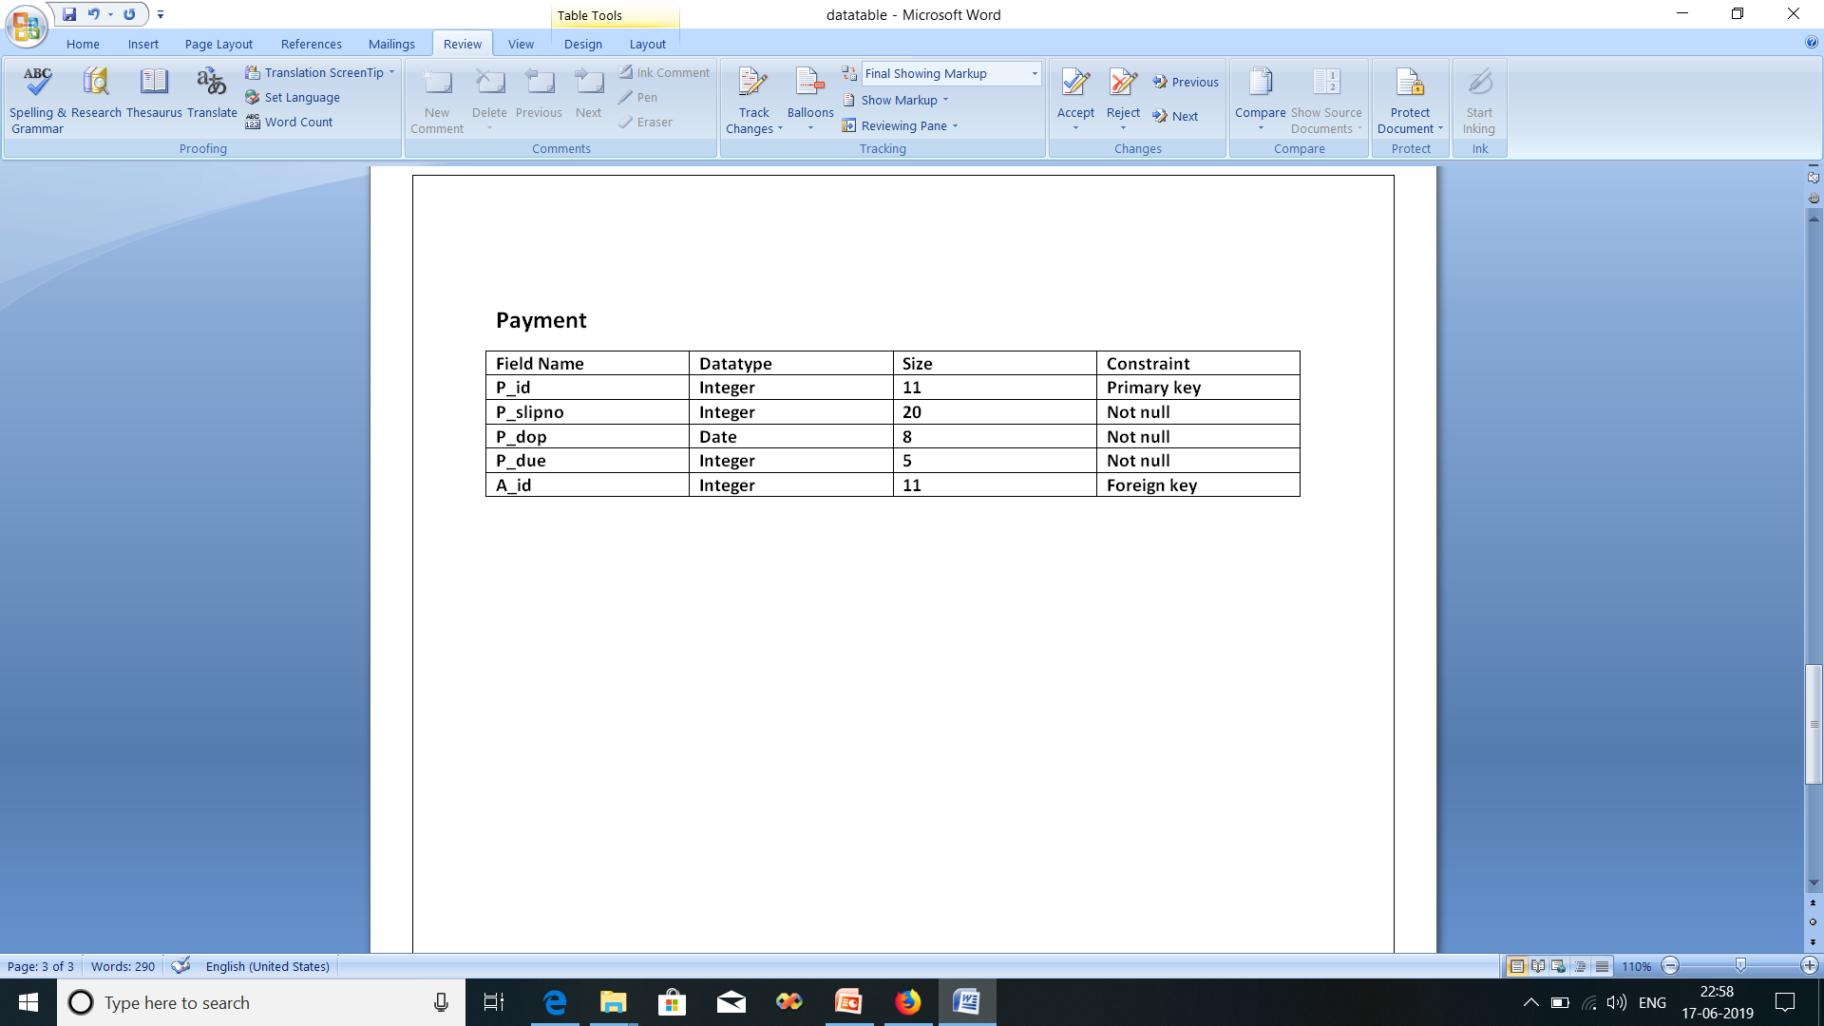

Slide 12
CONCLUSION
The Admission Management System is the main aim of the student’s future. The project is all about admission process or system. It is the process through which students enter tertiary education at universities and colleges. Admission manages by the institution. The student who has applied will be selected depends on their criteria which decided by the institutions. All the processes can be done by knowing each and every process in details

